Slide 1

Optimizing HVAC Controls using Machine Learning
Aniruddha Joshi
DSC 680
Dec 21, 2024

Slide 2

Introduction
Buildings are significant energy consumers, with HVAC systems playing a major role.
Optimizing HVAC usage is crucial for energy conservation and cost reduction.
Maintaining occupant comfort is essential for well-being and productivity.

Slide 3

Business Problem
Thermal comfort is influenced by various environmental factors (temperature, humidity, air velocity) and personal factors (clothing, activity level).
Traditional HVAC systems often rely on static settings that do not adapt well to individual preferences and dynamic conditions.

Slide 4
Predicting Thermal Comfort with Machine Learning
Large datasets of real-world comfort evaluations and environmental data enable the development of predictive models.
These models can inform more intelligent and responsive HVAC control strategies.

Slide 5
Data Source
The dataset contains over 80,000 records of indoor climate observations and individual comfort evaluations.
It includes a wide range of environmental and personal factors.
https://www.kaggle.com/datasets/claytonmiller/ashrae-global-thermal-comfort-database-ii/data

Slide 6
Preparing the Data for Analysis
Removing invalid or incomplete rows
Converting categorical data into a suitable format
Selecting the most relevant features (columns) for analysis.

Slide 7
Key Factors Influencing Thermal Comfort
Environmental factors: Temperature, humidity, air velocity
Personal factors: Clothing level, metabolic rate
Location information: Building type
Individual feedback: Thermal sensation vote

Slide 8
Key Factors Influencing Thermal Comfort
Environmental factors: Temperature, humidity, air velocity
Personal factors: Clothing level, metabolic rate
Location information: Building type
Individual feedback: Thermal sensation vote

Slide 9
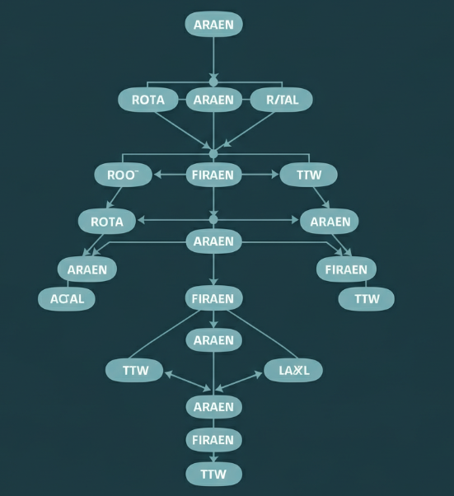
Predicting Thermal Comfort with Random Forest Classifier
Random Forest is a suitable algorithm for classification tasks with multiple features.
The model is trained on a portion of the dataset and evaluated on unseen data.

Slide 10
Model's Predictive Accuracy
Accuracy: 0.54 - Overall correctness of the model.
Precision: 0.27 - How often the model is correct when it predicts the positive class.
Recall: 0.27 - How often the model correctly identifies the positive class out of all actual positive instances.
F1-score: 0.26 - Harmonic mean of precision and recall.
The model's accuracy is currently moderate, suggesting potential for improvement.
Low precision and recall indicate a high number of false positives and false negatives.
Further analysis is needed to understand the reasons for misclassifications.

Slide 11

Conclusion
This project demonstrates the potential of machine learning to predict thermal comfort and optimize HVAC systems.
The developed model can contribute to significant energy savings while prioritizing occupant well-being.
Further research and development needed to enhance the model's accuracy and expand its applications.

